Slide 1
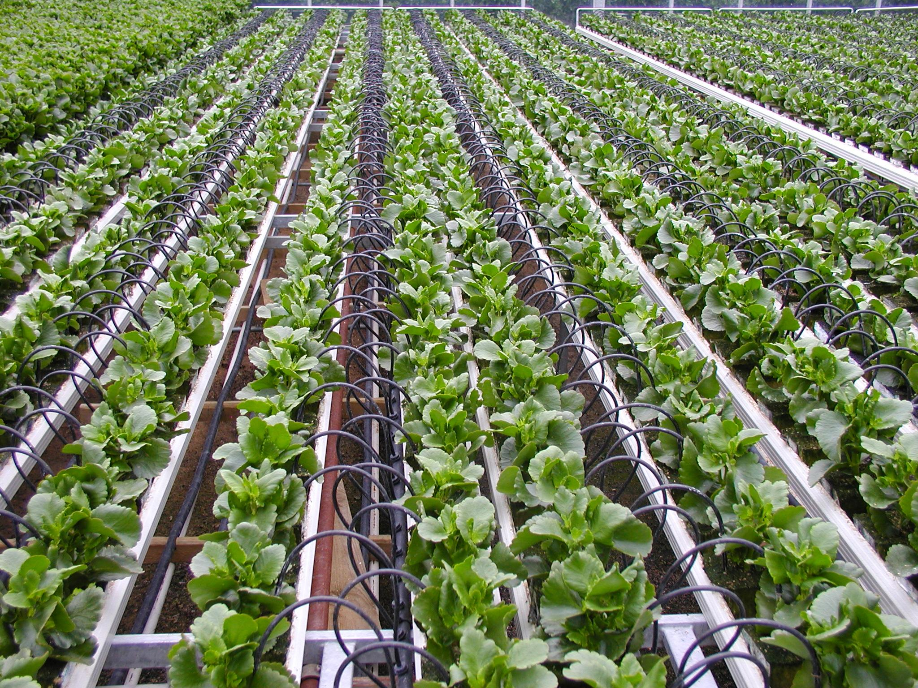
IOT based Automatic Irrigation System

Slide 2
Irrigation is the artificial
application of water to
soil

Slide 3
Problem statement
Knowing when and how much to water is 2 important aspects of irrigation.
A system to automate irrigation process is needed

Slide 4
Objective
Minimize manual intervention of the farmer
Prevent excess wastage of water and electricity
Optimize the yield

Slide 5
Solution
A wifi based automation system which can be extended by adding modules as the farm expands

Slide 6
Components required

Slide 7
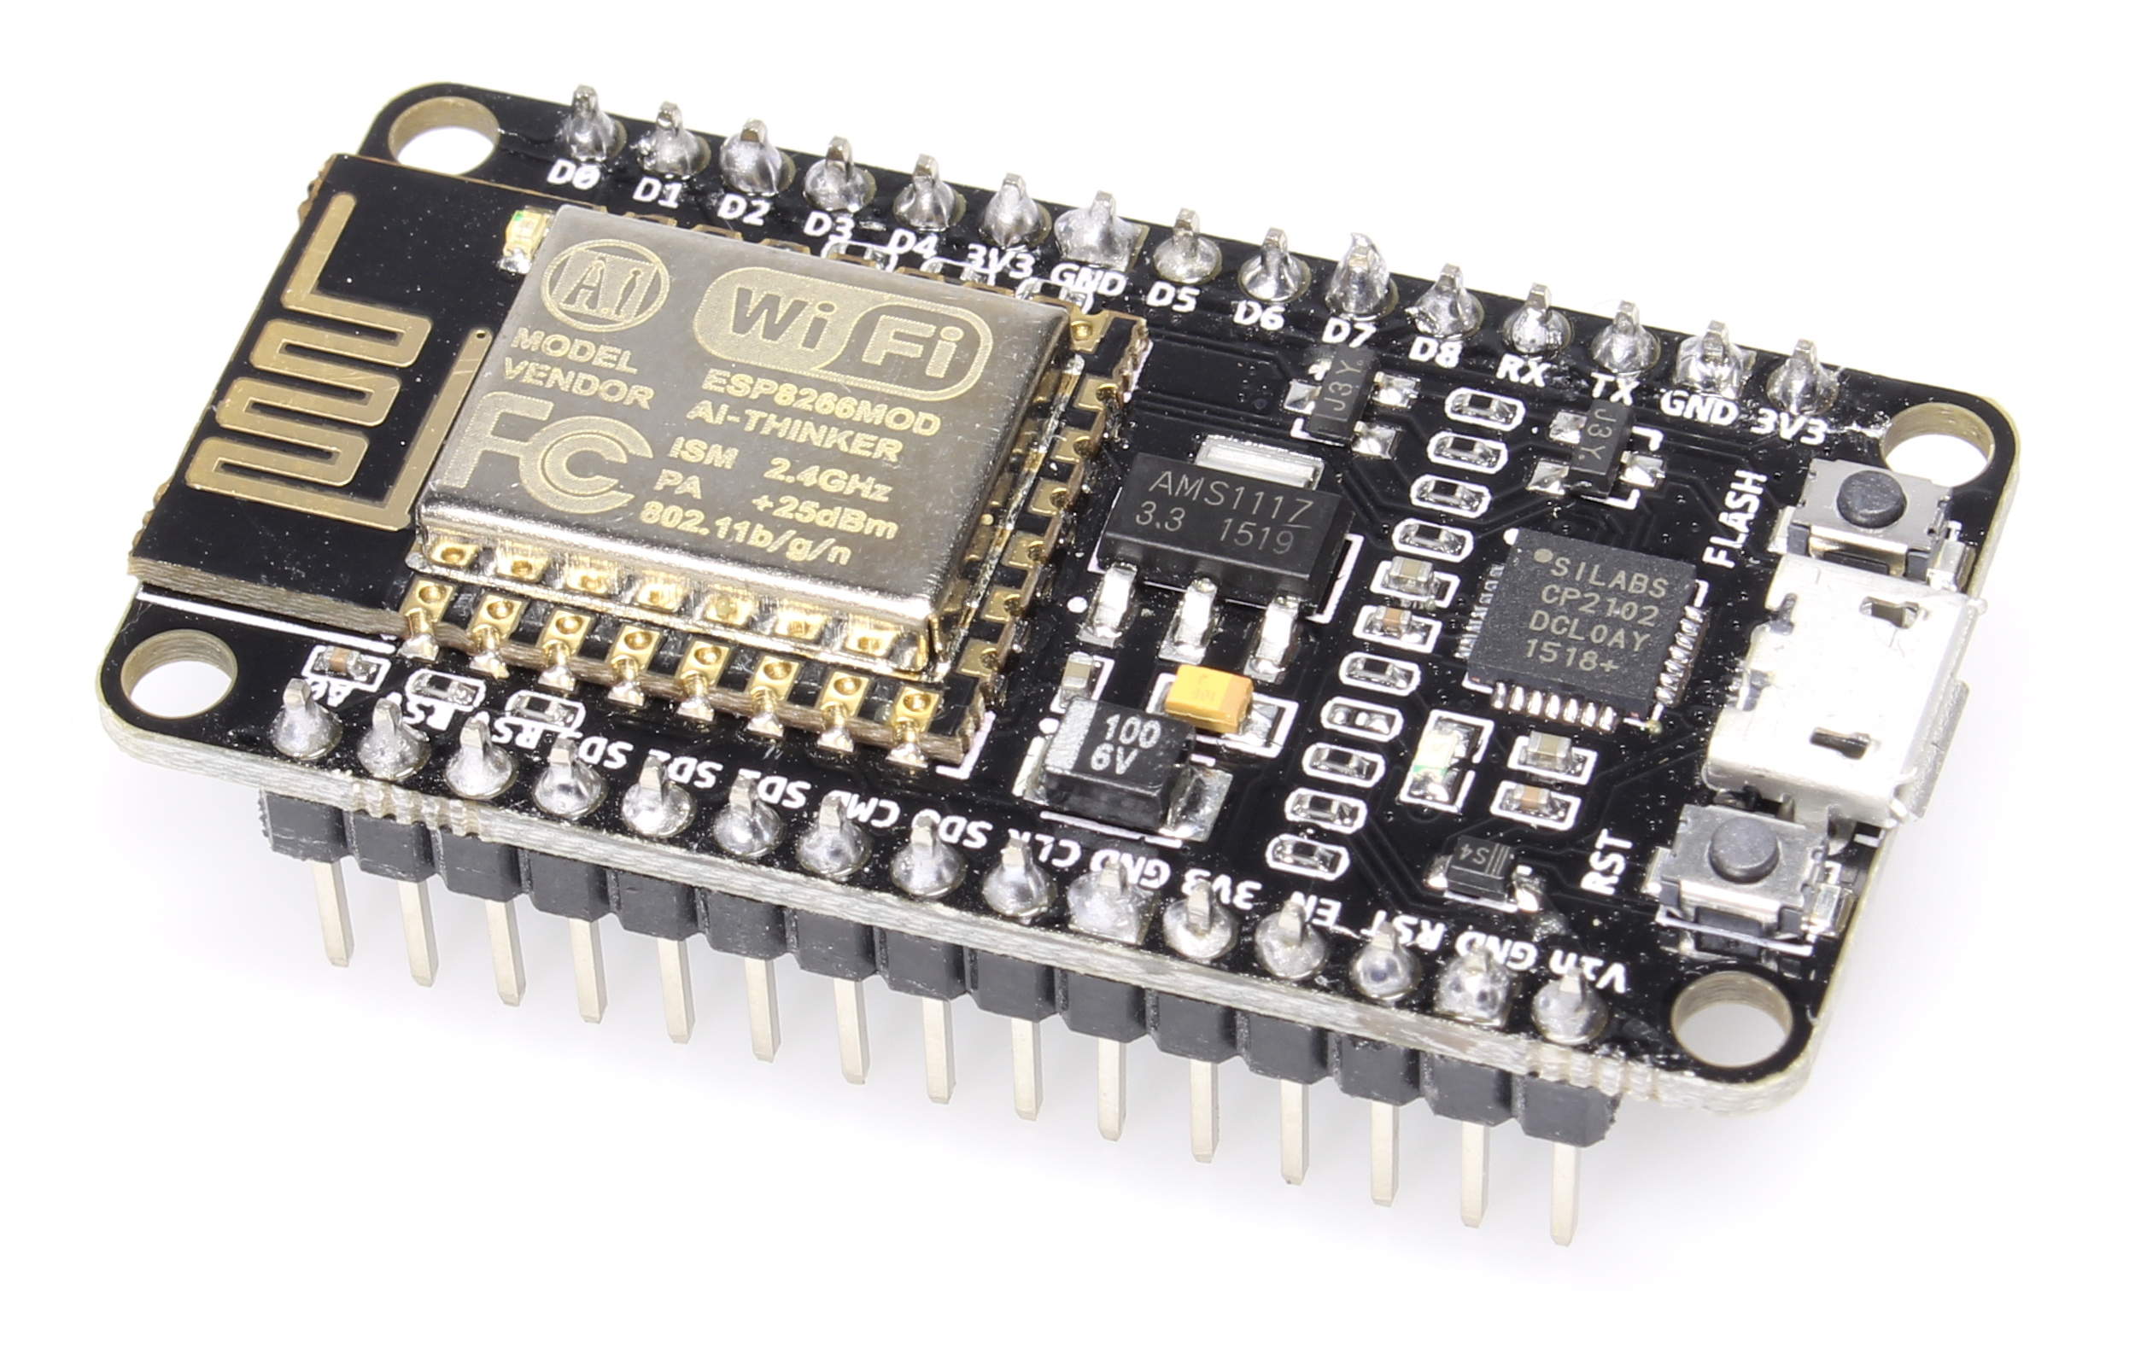
NodeMCU

Slide 8
NodeMCU
It is a popular wifi module with inbuilt microcontroller made by Espressif. It can be programmed with arduino software and the cost of the device is around rs 500. This makes it a widely used module within electronics enthusiasts. It has
10 GPIOs
I2C
SPI
ADC

Slide 9
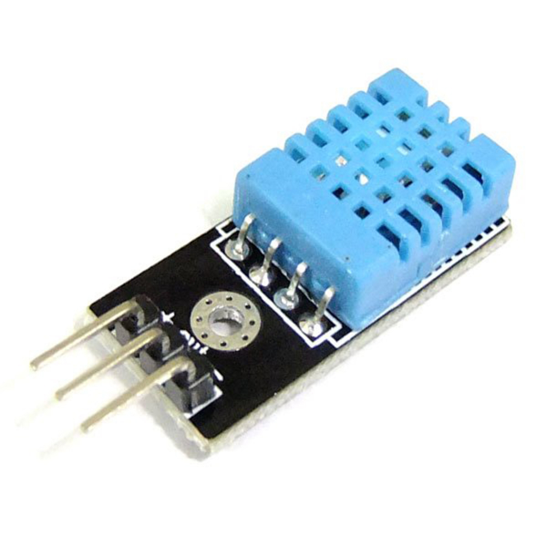
DHT11

Slide 10
DHT11
It is a temperature and humidity sensor module which is capable of outputting digital data. More precise successor is available in the market in the name dht22

Slide 11
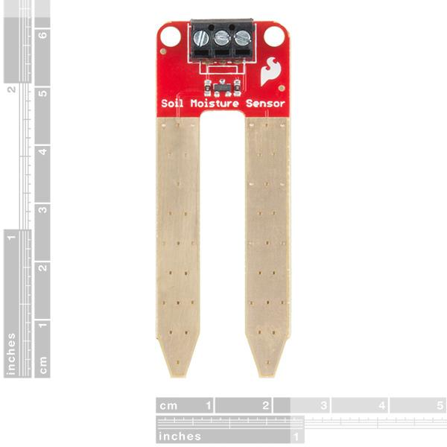
Soil moisture sensor

Slide 12
Soil moisture sensor
It basically consists of two metal plates separated by a distance. VCC is applied to one of the plates and reading is taken in analog form from the other.
The principle of working is that the moist soil has varying levels of conductivity depending on the water content.

Slide 13
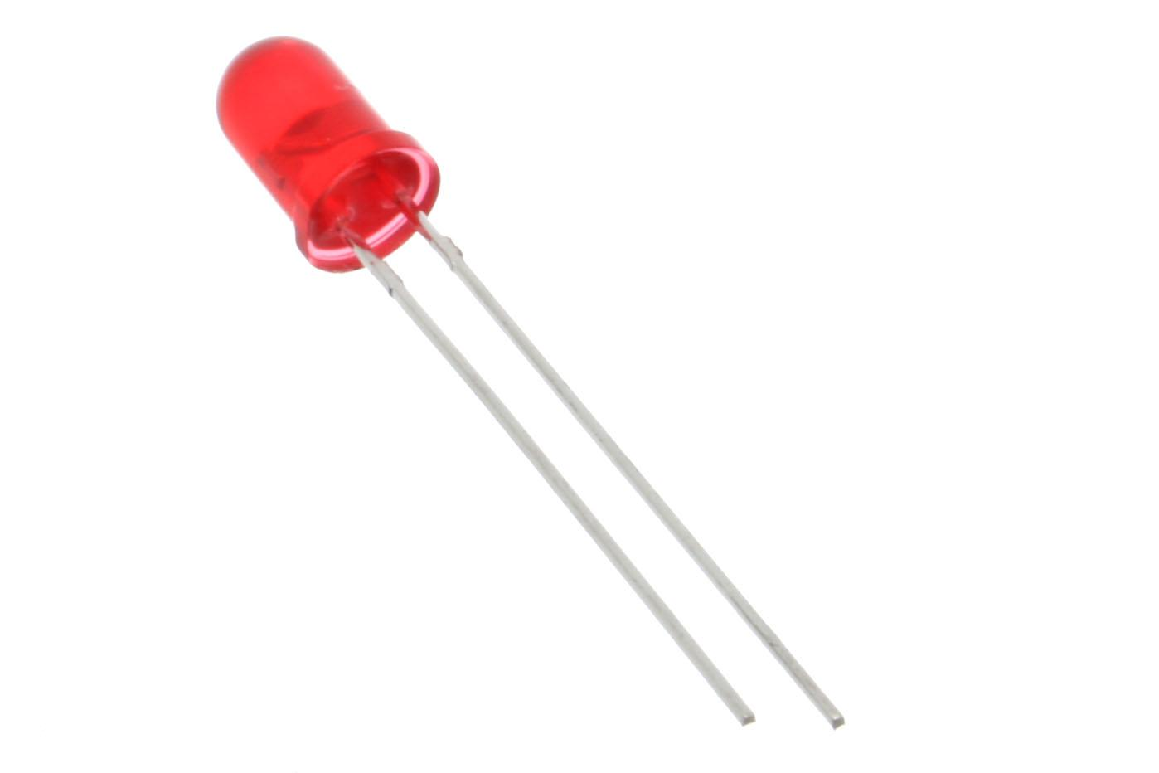
LED

Slide 14
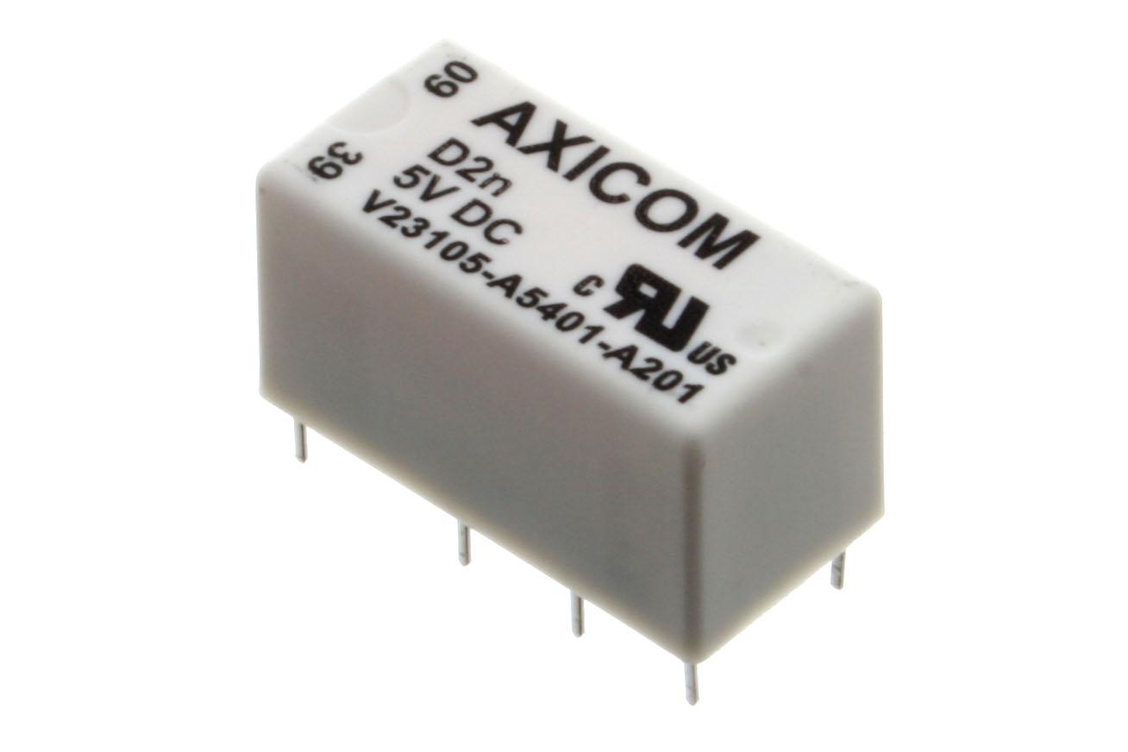
Relay

Slide 15
Relay
Relay can be used to switch on or off an motor or a solenoid valve which controls the water flow.

Slide 16
IOT Dashboard- Thinger.IO
Thinger.IO is an open source IOT platform to which devices can connect using internet. It provides an interface for different nodes to communicate in a network

Slide 17
Working
The project uses nodeMCU to control the motor. The nodeMCU is programmed using the Arduino IDE software.
The moisture sensor senses the level of moisture in the soil and sends the signal to the IOT dashboard if watering is required.
The motor or water pump supplies water to the plants until the desired water level is reached which is preset using the threshold slider.
Additional components like lights can be controlled using the IOT dashboard.

